Slide 1
Docker Installation
1. VirtualBox/VMware/hyper-v Installation
2. Virtual image and repository
http://kb.roamware.com/repo/isos/
3. Docker Installation
a. Docker repo(yum/apt/dnf)
sudo yum install -y yum-utils
sudo yum-config-manager --add-repo https://download.docker.com/linux/rhel/docker-ce.repo
b. Installing Docker
sudo yum install docker-ce docker-ce-cli containerd.io docker-compose-plugin
4. Run Docker Engine
sudo systemctl start docker

Slide 2
What is docker image exactly?
An Application along with its dependencies(environment and libraries) bundled together in a file.
Container is instance of an image.

Slide 3
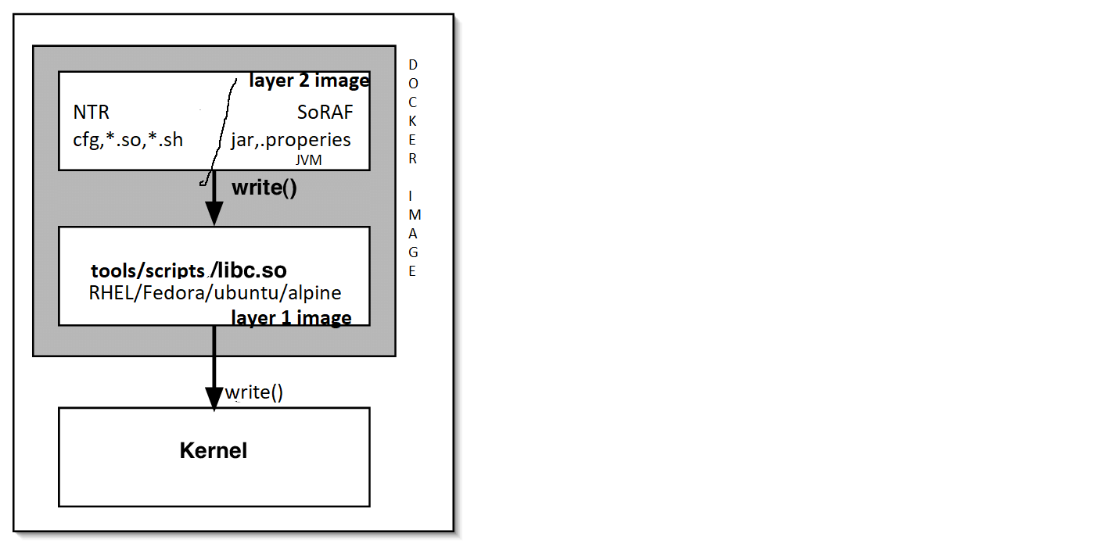

Slide 4
What is Parent Image?
This parent image is an OS without kernel
It has softwares/tools/Libraries based on the different Linux distributions.

Slide 5
What is Docker registry?
A Docker registry is a repository for Docker images.
Registries in the market
Docker hub,
Azure Container Registry,
Google Container Registry,
Github Container Registry

Slide 6
What is Dockerfile?
It is file containing instructions to build the docker image

Slide 7
What are Docker image layers?
Each image can be made up from the many small images.
Each instruction in a Dockerfile results in a layer.
Layers are used to avoid transferring redundant information and skip build steps which have not changed.

Slide 8
Operations on docker image
build Build an image from a Dockerfile
inspect Display detailed information on one or more images
pull Pull an image or a repository from a registry
push Push an image or a repository to a registry
rm Remove one or more images
save Save one or more images to a tar archive
load Load an image from a tar archive or STDIN
tag Create a tag TARGET_IMAGE that refers to SOURCE_IMAGE

